Slide 1
Lanthanoids and Actinoids- I
Dr. Semanti Basu
Assistant Professor
Department of Chemistry
Bejoy Narayan Mahavidyalaya Itachuna, Hooghly, W.B., India

Slide 2
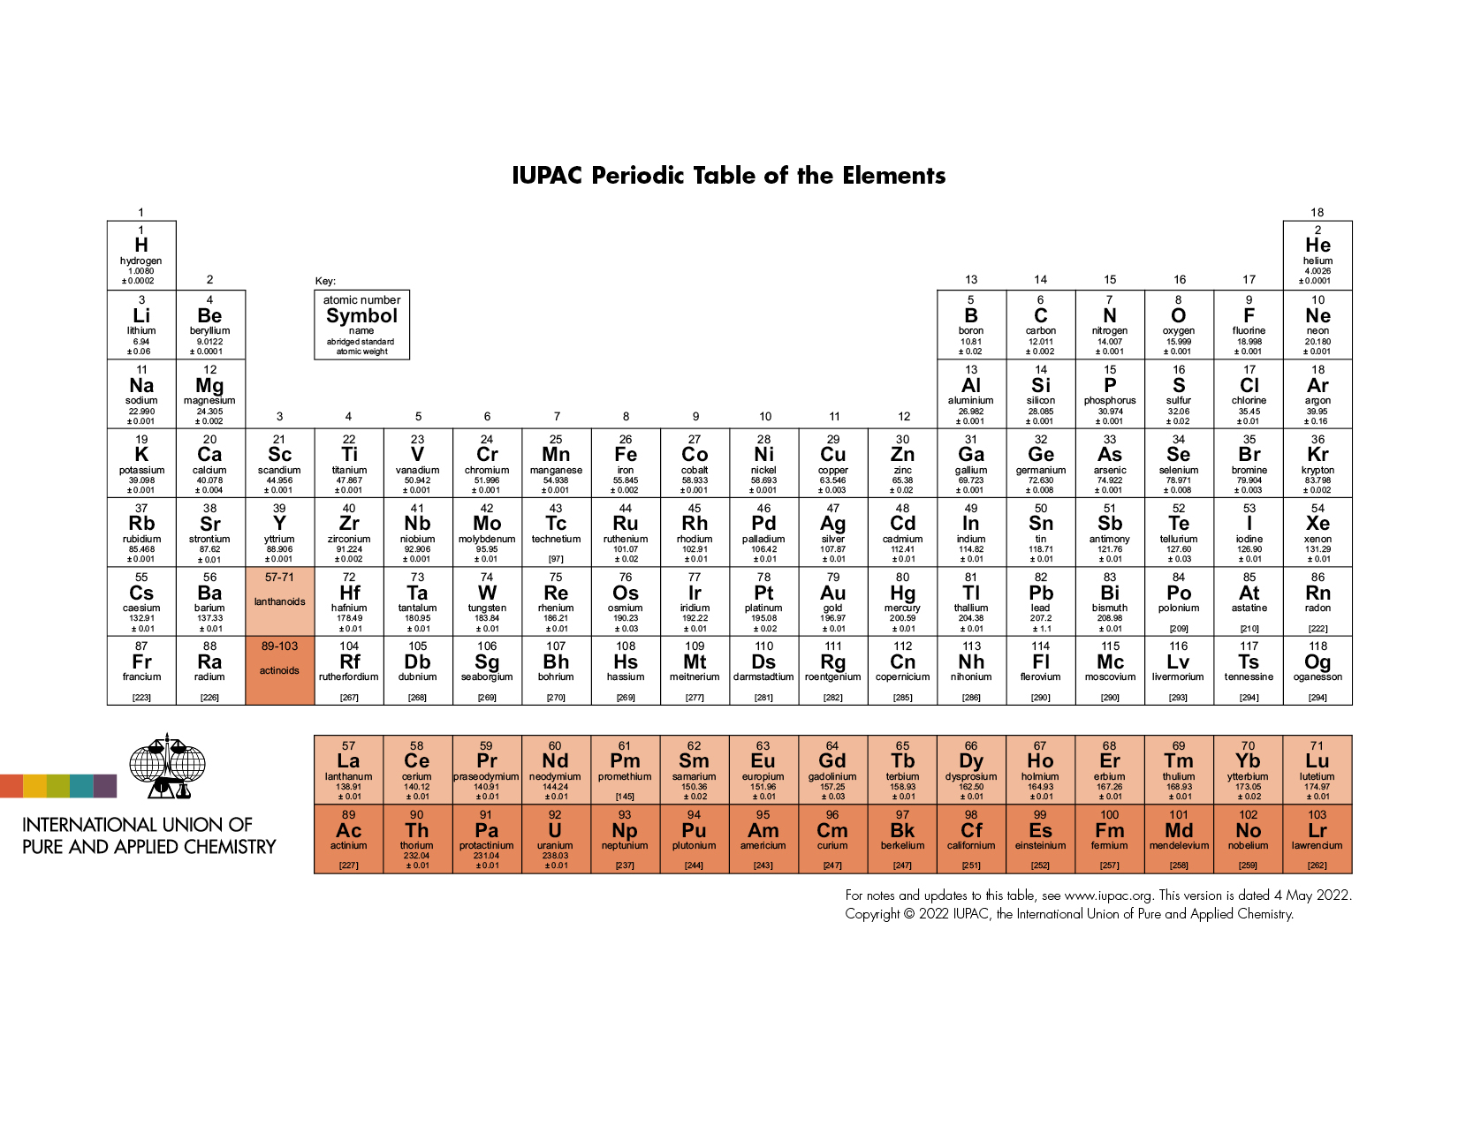

Slide 3
Syllabus
Electronic configuration
Lanthanide Contraction
Oxidation State
Colour & spectral properties
Magnetic properties
Separation of Lanthanides (ion exchange method only)

Slide 4
f-block elements
The f-block elements are those elements whose last electron (differentiating electron) enters into the (n-2)f-orbital at the valence shell. General electronic configuration of them is ns² (n-1)d⁰⁻¹ (n-2)f⁰⁻¹⁴ . Since the last electron of them enter into (n-2) shell, they are called inner-transition elements. If the last electron enter into 4f orbital then are called Lanthanide and if enters into 5f orbital then they are called Actinide
All the f-block elements are metal.

Slide 5
f-block elements
A total of 14 elements (₅₈Ce to ₇₁Lu) of lanthanide are placed in the place of group 3 and period 6. Though there is no electron at 4f orbital of Lanthanum (₅₇La), La are placed at the Lanthanide group because the properties of La is similar with the other 14 elements. There 15 elements of Lanthanide group are generally represented by “Ln”. The old name of Ln are rare earth elements.

Slide 6
f-block elements
A total of 14 elements of Actinide are placed in the place of group 3 and period 7. Therefore f-block elements have two series:
Lanthanide series or 4f series: Cerium (₅₈Ce) to Lutetium (₇₁Lu) total 14 elements are in this series. IUPAC recommended name is lanthanoid and the widely used name is lanthanide. General electronic configuration is [Xe]6s² 4f¹⁻¹⁴ 5d⁰⁻¹
Actinide series or 5f series: Thorium (₉₀Th) to Lawrencium (₁₀₃Lr) total 14 elements. These 14 elements are radioactive. From Americium (₉₅Am) to Lawrencium ₁₀₃Lr, 8 elements are artificially made elements. IUPAC recommended name is actinoids and the widely used name is actinides. General electronic configuration is [Rn]7s² 5f¹⁻¹⁴ 6d⁰⁻¹

Slide 7
Lanthanides (Ce to Lu) (or lanthanoids) and actinides (Ac to Lr) (or actinoids):
The placement of the lanthanides or actinides in a particular position is justified from the fact that the properties of the members in each family (ie lanthanides or actinides) are very much comparable though their atomic weight (more correctly atomic number) changes from one member to another.

Slide 8
Position in Periodic table – In 6th period & Group 3 after La the incoming electron enters the 4f orbital and the following 14 elements are called Lanthanide/Lanthanones. Placed outside the body of main periodic table as they resemble each other very closely and keeping them inside the main table will over rule periodic law.
Electronic configuration - The general electronic configuration of these elements is
ns² (n-1)d⁰⁻¹ (n-2)f¹⁻¹⁴
They resemble each other very closely as they have same electronic configuration in nth and (n-1) valency shell. Their most common oxidation state is +3 involving only 5d1 and 6s2 electrons. An alternate electronic configuration is also suggested that after Ce, the d electron also shifts to 4f orbital, except for those elements where it will disturb f¹ or f¹⁴ configuration.

Slide 9
For lanthanides
General Electronic configuration is [Xe]6s² 4f⁰⁻¹⁴ 5d⁰⁻¹

Slide 10
Element | Symbol | Idealized | Observed | Ln(+3) | Radius of Ln(+3) in pm
Lanthanum | ₅₇La | [Xe]6s² 4f⁰ 5d¹ | [Xe]6s² 4f⁰ 5d¹ | [Xe]4f⁰
 | ₅₈Ce | [Xe]6s² 4f¹ 5d¹ | [Xe]6s² 4f² 5d⁰ | [Xe]4f¹ | 114
 | ₅₉Pr | [Xe]6s² 4f² 5d¹ | [Xe]6s² 4f³ 5d⁰ | [Xe]4f² | 113
 | ₆₀Nd | [Xe]6s² 4f³ 5d¹ | [Xe]6s² 4f⁴ 5d⁰ | [Xe]4f³ | 111
 | ₆₁Pm | [Xe]6s² 4f⁴ 5d¹ | [Xe]6s² 4f⁵ 5d⁰ | [Xe]4f⁴ | 109
 | ₆₂Sm | [Xe]6s² 4f⁶ 5d⁰ | [Xe]6s² 4f⁶ 5d⁰ | [Xe]4f⁵ | 108
 | ₆₃Eu | [Xe]6s² 4f⁷ 5d⁰ | [Xe]6s² 4f⁷ 5d⁰ | [Xe]4f⁶ | 107
 | ₆₄Gd | [Xe]6s² 4f⁷ 5d¹ | [Xe]6s² 4f⁷ 5d¹ | [Xe]4f⁷ | 105
 | ₆₅Tb | [Xe]6s² 4f⁸ 5d¹ | [Xe]6s² 4f⁹ 5d⁰ | [Xe]4f⁸ | 104
 | ₆₆Dy | [Xe]6s² 4f⁹ 5d¹ | [Xe]6s² 4f¹⁰ 5d⁰ | [Xe]4f⁹ | 103
 | ₆₇Ho | [Xe]6s² 4f¹⁰ 5d¹ | [Xe]6s² 4f¹¹ 5d⁰ | [Xe]4f¹⁰ | 102
 | ₆₈Er | [Xe]6s² 4f¹¹ 5d¹ | [Xe]6s² 4f¹² 5d⁰ | [Xe]4f¹¹ | 100
 | ₆₉Tm | [Xe]6s² 4f¹² 5d¹ | [Xe]6s² 4f¹³ 5d⁰ | [Xe]4f¹² | 99
 | ₇₀Yb | [Xe]6s² 4f¹³ 5d¹ | [Xe]6s² 4f¹⁴ 5d⁰ | [Xe]4f¹³ | 99
 | ₇₁Lu | [Xe]6s² 4f¹⁴ 5d¹ | [Xe]6s² 4f¹⁴ 5d¹ | [Xe]4f¹⁴ | 98

Slide 11
2. f-CONTRACTION OR LANTHANIDE AND ACTINIDE CONTRACTION
Lanthanide contraction (4f) and actinide contraction (5f) both are called f-contraction. The term "lanthanide contraction" refers to the larger than expected decrease in atomic or ionic radii (M³⁺ ions) of lanthanide elements (4f) from lutetium (₇₁Lu) to lanthanum (₅₇La) (fig.).
Similar to lanthanide, the atomic and ionic radii of the actinide series (Th to Lr) progressively decrease larger than expected as the atomic number increases. this decrease in size is referred to as actinide contraction.

Slide 12
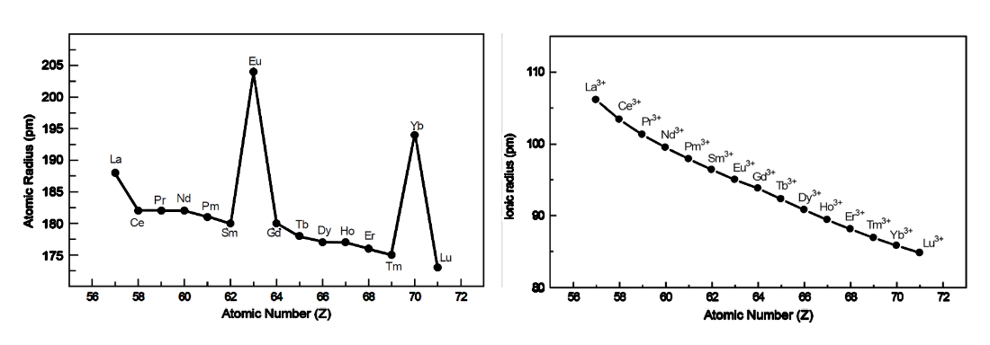
The ionic radii of Ln⁺³ exhibit a consistent downward trend from La⁺³ to Lu⁺³, although this trend is comparatively slower for the later members. Their metallic radii, however, do not decrease monotonically, leading to two hikes: at ₆₃Eu ([Xe]4f⁷ 5d⁰ 6s²) and ₇₀Yb ([Xe]4f¹⁴ 5d⁰ 6s²). The electronic configurations of these two elements are full-filled (Yb) and half-filled (Eu), which gives them extra stability.
(a) Atomic radius in Å and (b) Ionic radius (at +3 oxidation state) in Å of Lanthanide series

Slide 13
Cause of f-Contraction
Mainly f-contraction occurs for relativistic effect and increasing trend of effective nuclear charge (Z_{eff}). The general electronic configuration of lanthanide is [Xe] 4f ¹ ⁻ ¹⁴ 5d ⁰ ⁻ ¹ 6s ² and actinide is [Rn] 5f ¹ ⁻ ¹⁴ 6d ⁰ ⁻ ¹ 7s ².
Ineffective shielding of 4f electrons produces the contraction of 6s electron. The shielding effect is the phenomenon where the outer-shell electrons are protected from nuclear charge by the inner-shell electrons. Therefore, when the shielding is less effective, the positively charged nucleus will have a stronger attraction to the electrons, which will cause the atomic radius to decrease. The order of shielding is: s orbital > p orbital > d orbital > f orbital.

Slide 14
Cause of Lanthanide contraction
Electrons in f-orbitals repel one another very weakly because the lobes of f-orbitals are far apart from each other.
Poor shielding effect of f-electrons shielding of electrons decreases in the order s>p>d>f. Thus, the effective nuclear charge increases with the increase in atomic number of lanthanides. This increase the inward pull of the 4f electrons and results in the reduction of the size of the atom or ion.
This contraction in the size of the atom or ion by pulling the valence electrons inward due to high nuclear charge and the poor shielding effect of the f-electron is the main cause of lanthanide contraction.
Table: Atomic radii of the elements before and after lanthanides
As a result of lanthanide contraction, the chemistry of 2nd and 3rd transition series resemble each other than the elements of 1st and 2nd transition series.

Slide 15
Effect of Lanthanide Contraction
The Lanthanide contraction is extremely important to understand the properties of lanthanide itself and post-lanthanide elements.
Among the lanthanides
Post lanthanides
1. Effect of Lanthanide Contraction on the Properties of Lanthanides
With the gradual decrease of size occurs from La(III) to Lu(III), the gradual increase of the ionic potential occurs
$[ionic potential \left(φ\right)= \frac{charge}{radius}$)]. As a result,
Covalent character increases from La(III) to Lu(III).
Hydration energy for Ln⁺³ ion gradually increases from La⁺³ to Lu⁺³ because of the increase of ionic potential ($φ$).
Tendency to hydrolyse increases from La(III) to Lu(III).
Stability and tendency to form the coordination compounds increase from La(III) to Lu(III).
The common +3 oxidation state of lanthanide (Ln⁺³) indicates that the removal of three electrons from valence 6s-and 5d shell (5d¹ 6s²) is easy. The remaining 4f-electrons get tightly bound.

Slide 17
Effect of Lanthanide Contraction
6. Acidity of the oxides increases from La₂O₃ to Lu₂O₃
7. Thermal stability of the oxy salts (e.g. carbonates, sulphates, etc.) decreases from La(III) to Lu(III).
8. Crystallographic radii decrease from La⁺³ to Lu⁺³ while their hydrated radii follow the opposite order because the smaller Ln⁺³ ions are hydrated better for their higher charge/radius ratio.
9. Summation of fast three ionisation energy (I₁ + I₂ + I₃) gradually increases from La to Lu with two significant peaks at Eu and Yb which represent the loss of an electron from the stable half-filled 4f⁷ and full filled 4f¹⁴ levels, respectively.
10. Effect on the basic strength of hydroxides: The ionic size of the lanthanide series gradually decreases from La ³⁺ to Lu ³⁺ for lanthanide contraction. As a result, according to Fajan’s rule, the covalent characteristics of lanthanide metal hydroxide complexes steadily rise from lanthanum to lutetium. Lu (OH)₃ is therefore more covalent than La (OH)₃. The basic strength of lanthanide metal hydroxide decreases from La ³⁺ to Lu ³⁺. Thus La (OH)₃ is the most basic whereas Lu (OH)₃ is the least basic.

Slide 18
Effect of Lanthanide Contraction
2. Low Atomic and Ionic Radii of the Post-lanthanide Elements
The same group elements in the 4d series and the 5d series are nearly the same size due to relativistic effects and lanthanide contraction. Along a group from top to bottom, the size increases as the principal quantum number increases. Generally, s- and p-block elements follow this trend. However, the elements of a specific group of the 4d and 5d series are nearly equal in size. As a result, the sizes of the elements in each pair: Zr and Hf; Nb and Ta; Tc and Re; Ag and Au; and Cd and Hg become almost identical. This happens so for the lanthanide contraction to the postlanthanides.

Slide 19
Effect of Lanthanide Contraction
2. Low Atomic and Ionic Radii of the Post-lanthanide Elements
metallic radii in pm & () = covalent radii in pm
Group & Period | 3 | 4 | 5 | 6 | 7 | 8 | 9 | 10 | 11 | 12
3d | Sc 164 (144) | Ti 147 (132) | V 134 (122) | Cr | Mn 137 (117) | Fe | Co | Ni | Cu 128 (117) | Zn 137 (125)
4d | Y 182 (162) | Zr 167 (145) | Nb 147 (134) | Mo | Tc 135 | Ru | Rh | Pd | Ag 144 (134) | Cd 152 (141)
5d | La 188 (169) | Hf 159 (144) | Ta 147 (134) | W | Re 137 (128) | Os | Ir | Pt | Au 144 (134) | Hg 153 (144)

Slide 20
Effect of Lanthanide Contraction
3. Similarity of Chemical Properties Between the Elements of the Same Group of 4d and 5d Series
The size of the elements in the same group of 4d and 5d series are almost same for lanthanide contraction. Since the chemical and physical properties of the elements are largely governed by the ionic potential (charge/radius). The chemical and physical properties become almost identical for the members of 4d and 5d in the same group. For example, the chemical properties of the following pairs are similar: Zr and Hf; Nb and Ta; Tc and Re; Ag and Au; Cd and Hg etc. They are so similar in their chemical behavior that it is a very difficult task to separate them chemically. Because of the same ground, Zr and Hf occur naturally in the same source. The same thing also happens for the other pairs.

Slide 21
Effect of Lanthanide Contraction
4. Chemically Inertness
5. High Density among the Post-Lanthanide Elements (5d)
At post lanthanide series with increasing atomic number atomic weight also increases. But their size gradually decreases from ₇₂Hf to ₇₇Ir, and after that, from Ir to ₇₉Au a slight increase in size occurs. This occurs for the lanthanide contraction. This is why, the densities of such metals are extremely high and iridium has the highest density. The density of the iridium is 23.7 x 10³ kg $m^{−3}$.

Slide 22
Effect of Lanthanide Contraction
6. Ionization Energy and Electronegativity
Among the post lanthanides elements with increasing atomic number (Z) size of the element decreases as a consequence of Lanthanide contraction. As a result, effective nuclear charge (Z_{eff}) increases with increasing atomic number. Therefore, ionization energy increases with increasing atomic number. The ionization energy of 5d elements is substantially higher than that of 4d and 3d. Gold and iridium have the highest ionization energy. As a result, they become less chemically reactive. For instance, the sixth-period elements, such as platinum (Pt), gold (Au), mercury (Hg), etc. have very low chemical reactivity. Therefore, these metals become noble. Electronegativity also increases from La to Lu.

Slide 23
Effect of Lanthanide Contraction
7. High Electron Affinities Among the Post Lanthanide Elements
Among the post lanthanides elements with increasing atomic number (Z) size of the element decreases as a consequence of Lanthanide contraction. As a result, effective nuclear charge (Z_{eff}) increases with increasing atomic number. Therefore, electron affinity increases with increasing atomic number. Gold (Au) shows the highest electron affinity ($\sim$ 223 kJ ${mol}^{−1}$) among all the metals; in fact, aurides (${Au}^{−}$) are reported in the compounds like Cs⁺${Au}^{−}$. Here the large cation Cs⁺ combines with the large anion ${Au}^{−}$ to form the ionic lattice of high lattice energy because of the better size matching (crystal packing) of the ions.

Slide 24
Effect of Lanthanide Contraction
8. The Separation of Lanthanides is Difficult
The properties of metal ions are determined by ionic potential $φ$ ($φ$ = charge/radius). All lanthanide ions have nearly similar sizes and charges due to lanthanide contraction, which makes them equivalent in all other respects. Thus, separating lanthanides from one another is quite difficult.
9. Occurrence of Yttrium (₃₉Y) with the Lanthanides
As the size of yttrium ₃₉Y is very much comparable with those of the members of the lanthanide series, its ionic potential $φ$ ($φ$ = charge/radius) is very much comparable to those of lanthanides. Consequently, it is very much chemically similar with the lanthanides. This is why, Y often occurs in nature with the lanthanides.

Slide 25
Effect of Lanthanide Contraction
At period 6 from left (gr. 13) to right (gr. 18) atomic radii becomes almost the same for lanthanide contraction.
At p-block elements from period 5 to period 6 atomic radius increases very slightly for the introduction of an additional 4f¹⁴ level. Now shielding of 4f¹⁴ < 5d¹⁰ level. Therefore, size of p-block elements of period 6 decreases significantly. This is called lanthanide contraction. Ex. atomic radii of In (1.44 $×{10}^{−10}$ m) < Tl (1.48 $×{10}^{−10}$ m); Sn (1.41 $×{10}^{−10}$ m) < Pb (1.47 $×{10}^{−10}$ m).
At p-block elements from period 6 to period 7 atomic radius increases very slightly for actinide contraction.
At d-block elements from period 5 (4d) to period 6 (5d) atomic radius becomes same for the introduction of an additional 4f¹⁴ level. Now shielding of 4f¹⁴ < 5d¹⁰ level. This is called Lanthanide contraction. Ex. atomic radii of Zr (1.45 $×{10}^{−10}$ m) $≈$ Hf (1.44 $×{10}^{−10}$ m); Ru (1.25 $×{10}^{−10}$ m) $≈$ Os (1.26 $×{10}^{−10}$ m).

Slide 26
Oxidation States
+3 is the stable oxidation state of all lanthanides.
2. Some lanthanides unstable in +2 & +4 O.S. They want to transfer into +3 OS. Ex-
Ce⁴⁺ + Fe²⁺ $→$ Ce³⁺ + Fe³⁺;
2 Sm²⁺ + 2H₂O → 2 Sm³⁺ + H₂ + 2OH⁻
+2,+3 & +4 oxidation states are stable for some lanthanides. For ex.
La⁺³ = [Xe] 4f⁰; Ce⁴⁺ = [Xe] 4f⁰; Eu²⁺ = [Xe] 4f⁷;
Gd³⁺= [Xe] 4f⁷, Tb⁴⁺ = [Xe] 4f⁷;
Yb²⁺ = [Xe] 4f⁷, Lu⁺³ = [Xe] 4f¹⁴ ;
Empty, half filled & full filled orbitals are more stable because exchange energy of them are maximum.

Slide 27
Oxidation States
3. For some lanthanides +2, +3 and +4 O.S. are stable though they are not empty pr half filled or full filled. For ex. Ce³⁺ = [Xe] 4f¹; Pr⁴⁺ = [Xe] 4f^{1 ;}
Ce²⁺ = [Xe] 4f² ; Pr³⁺ = [Xe] 4f²;
Nd⁴⁺ = [Xe] 4f²; Sm²⁺ = [Xe] 4f⁶
Dy²⁺ = [Xe]4f¹⁰; Tm²⁺ [Xe] 4f¹³
The stability of these ions can be explained by kinetic & Thermodynamic factors.
Oxide compounds of প্র্যাসিওডিমিয়াম (Pr), নিওডিমিয়াম (Nd), টারবিয়াম (Tb), ডিসপ্রোসিয়াম (Dy) shows +4 O.S.
 | La | Ce | Pr | Nd | Pm | Sm | Eu | Gd | Tb | Dy | Ho | Er | Tm | Yb | Lu
 | +3 | +3, +4 | +3, +4 | +3, +4 | +3 | +2, +3 | +2, +3 | +3 | +3, +4 | +3, +4 | +3 | +3 | +3 | +2, +3 | +3

Slide 28
Oxidation States
The configuration of La³⁺ ion, is that of xenon which is highly stable. So, it is not possible to have a La⁺⁴ ion.
In the same way Ga, Lu also form only +3 ions, because the removal of three electrons give stable half filled 4f⁷ configuration for Gd³⁺ ion and in completely filled 4f¹⁴ configuration for Lu³⁺ ions.
In other Lanthanides, +2 and +4 oxidations states also occur but these are always less table than the +3 oxidation state which is characteristic of this family.
The +2 and +4 oxidation states are shown by those elements which will attain f⁰, f7 and f14 configurations by doing so
For eg Ce⁴⁺& Eu²⁺: 4f⁷, Tb: f⁷, Yb²⁺: 4f¹⁴extra stability is associated with f⁰, f⁷, f¹⁴ configurations.

Slide 29
Symbol | Idealized | Observed | M³⁺ | M²⁺ | M⁴⁺ | At Radii A* | No of f electrons
La | [Xe]6s² 4f⁰ 5d¹ | [Xe]6s² 4f⁰ 5d¹ | [Xe] | - |  | 1.88 | 0
Ce | [Xe]6s² 4f¹ 5d¹ | [Xe]6s² 4f² 5d⁰ | 4f¹ | 4f² | [Xe] | 1.82 | 1
Pr | [Xe]6s² 4f² 5d¹ | [Xe]6s² 4f³ 5d⁰ | 4f² | - | 4f¹ | 1.83 | 2
Nd | [Xe]6s² 4f³ 5d¹ | [Xe]6s² 4f⁴ 5d⁰ | 4f³ | 4f⁴ | 4f² | 1.82 | 3
Pm | [Xe]6s² 4f⁴ 5d¹ | [Xe]6s² 4f⁵ 5d⁰ | 4f⁴ | - | - |  | 4
Sm | [Xe]6s² 4f⁶ 5d⁰ | [Xe]6s² 4f⁶ 5d⁰ | 4f⁵ | 4f⁶ | - | 1.80 | 5
Eu | [Xe]6s² 4f⁷ 5d⁰ | [Xe]6s² 4f⁷ 5d⁰ | 4f⁶ | 4f⁷ | - | 2.04 | 6
Gd | [Xe]6s² 4f⁷ 5d¹ | [Xe]6s² 4f⁷ 5d¹ | 4f⁷ | - | - | 1.80 | 7
Tb | [Xe]6s² 4f⁸ 5d¹ | [Xe]6s² 4f⁹ 5d⁰ | 4f⁸ | - | 4f⁷ | 1.78 | 8
Dy | [Xe]6s² 4f⁹ 5d¹ | [Xe]6s² 4f¹⁰ 5d⁰ | 4f⁹ | - | 4f⁸ | 1.77 | 9
Ho | [Xe]6s² 4f¹⁰ 5d¹ | [Xe]6s² 4f¹¹ 5d⁰ | 4f¹⁰ | - | - | 1.77 | 10
Er | [Xe]6s² 4f¹¹ 5d¹ | [Xe]6s² 4f¹² 5d⁰ | 4f¹¹ | - | - | 1.76 | 11
Tm | [Xe]6s² 4f¹² 5d¹ | [Xe]6s² 4f¹³ 5d⁰ | 4f¹² | 4f¹³ | - | 1.75 | 12
Yb | [Xe]6s² 4f¹³ 5d¹ | [Xe]6s² 4f¹⁴ 5d⁰ | 4f¹³ | 4f¹⁴ | - | 1.94 | 13
Lu | [Xe]6s² 4f¹⁴ 5d¹ | [Xe]6s² 4f¹⁴ 5d¹ | 4f¹⁴ | - | - | 1.73 | 14

Slide 30
Reference
Ashim K Das , Fundamental Concept of Inorganic Chemistry, CBC Publishers & Distributors, Volume 1

Slide 31
Thank you

